Slide 1
Greeting Routine:
Teacher: Good morning students.
Students: Good morning Mr. Melendez.
Teacher: How are you guys doing today?
Students: Fine thank you. And you?
Teacher: I’m doing great. Thank you. Hope you guys are doing great too.

Slide 2
Classroom Standard Procedures
Mr. Melendez
English Class
Tuesday, September 1st, 2015

Slide 3
Time Management:
Class
Greeting Activity
Introduction to Standard Procedures
Discussion of the Classroom Standard Procedures
Clarify any doubts and explain the homework

Slide 4
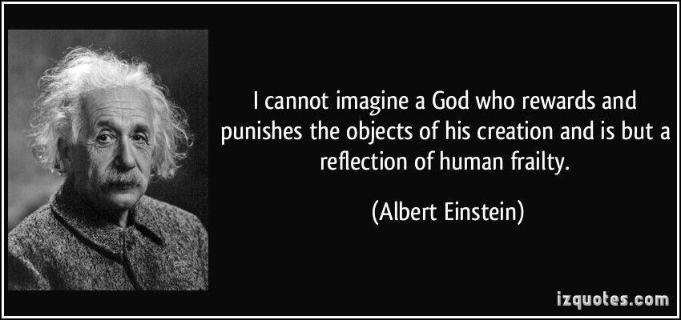
Opening Reflection:

Slide 5
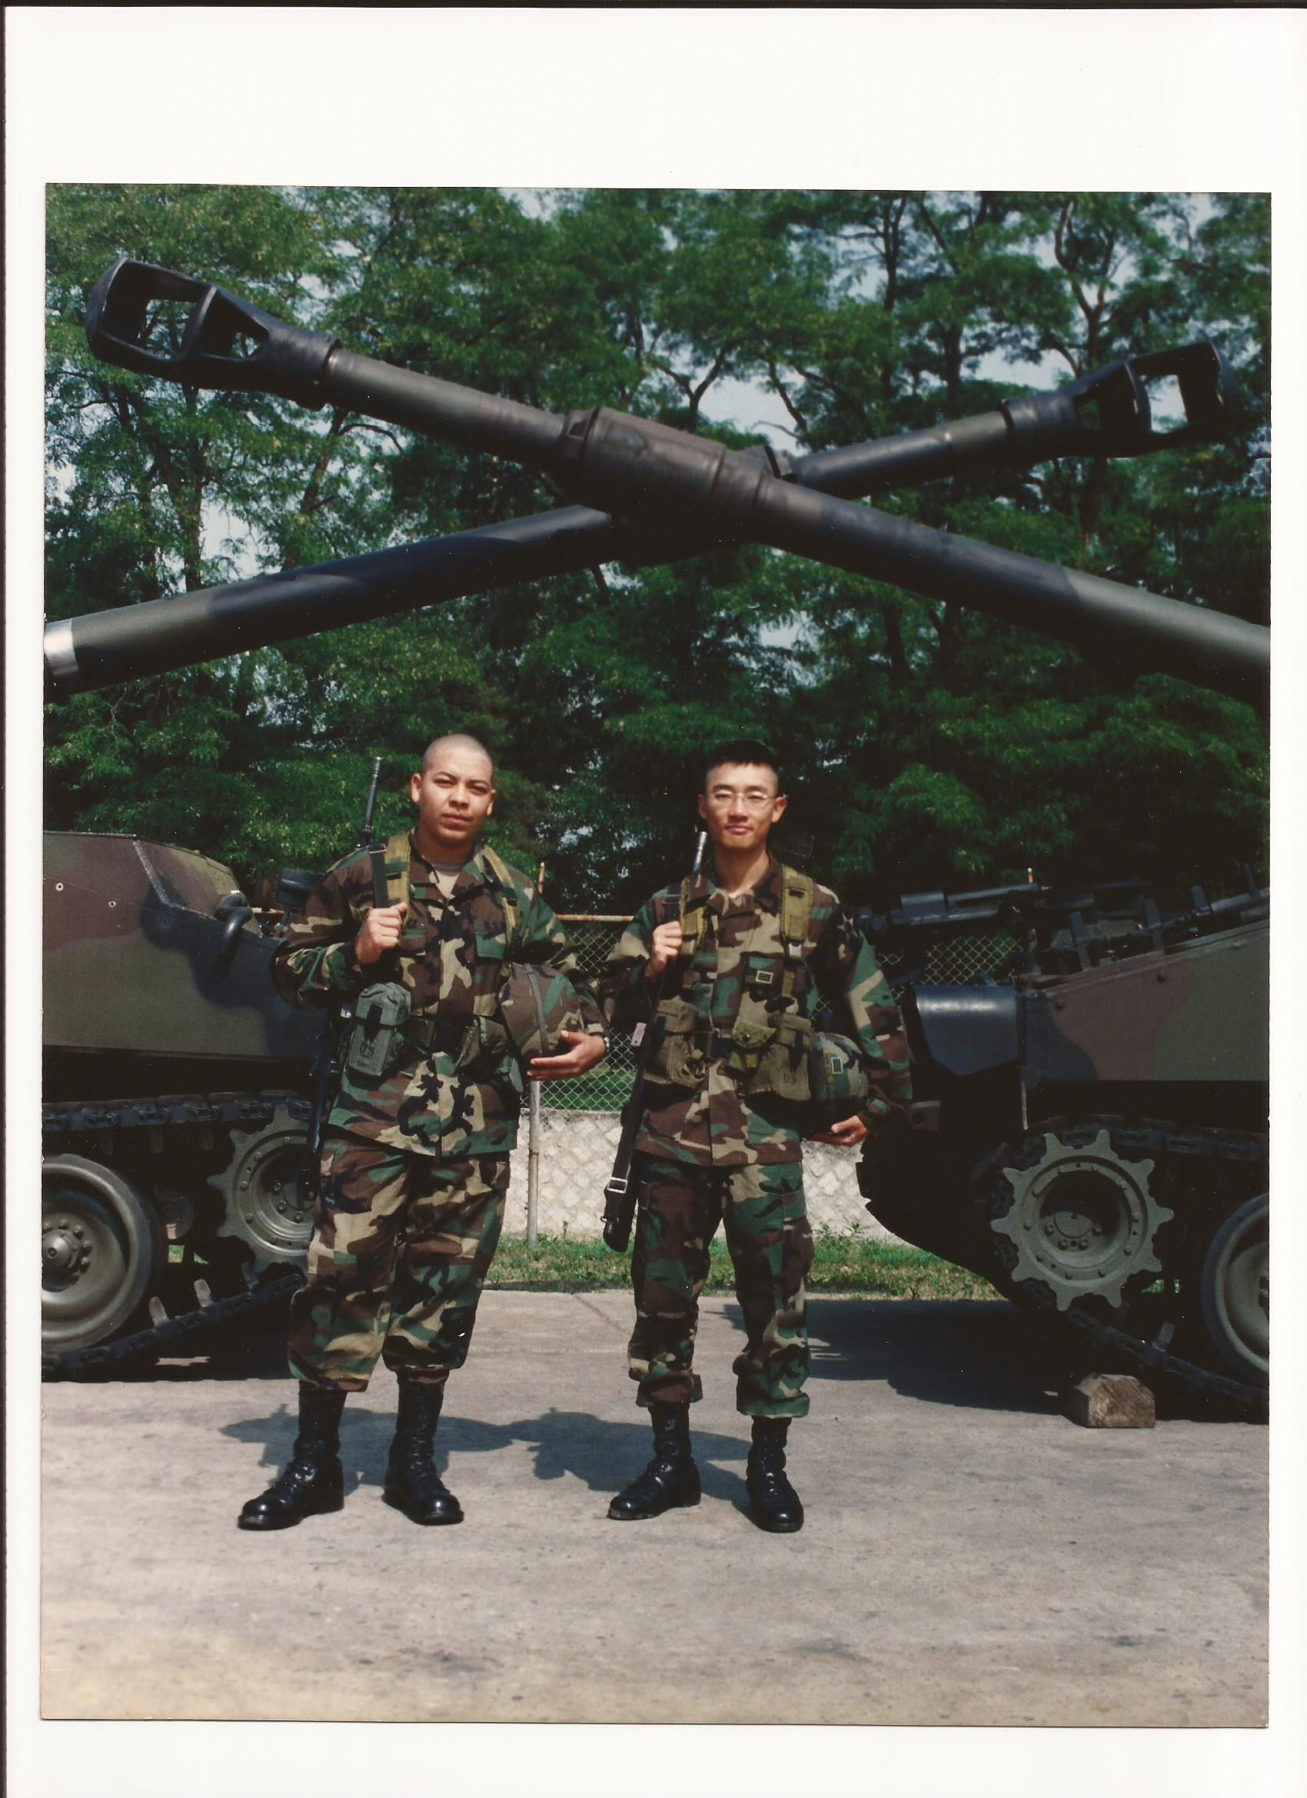
Diversity of backgrounds
Respect is expected at all times.

Slide 6
Introduction to the Classroom Standard Procedures:
Treat each person in this room with dignity and respect.
Follow directions the first time they are given. (Instructions will not be repeated to avoid wasting the educational time.)
Follow the guidelines stated in the course syllabus and discuss yesterday.
This classroom is a “NO WHINING ZONE”. Everything I do is in your best interest.

Slide 7
Standard Procedure #1: Infraction Notice
Please: Correct your behavior and return to class.
See me after class.
________________ _______________
Student Signature Date
Offense: ________________________________________________________________________________
Conference Result: _________________________________________________________________________________________

Slide 8
Standard Procedure #2: Parental Contact
Action Plan:
1. What is the problem?
2. What’s causing the problem?
3. What plan you will use to solve the problem?
_________________
Date
_________________ __________________
Student Signature Parent Signature

Slide 9
Standard Procedure #3: Disciplinary Referral
Will include a copy of Standard Procedure 1 and 2.
It will be made to the social worker.
Note:
I don’t expect to use it but if I have to I will.

Slide 10
Standard Procedure #4: Getting ready for class
Have a seat.
Take out your notebook and pen/pencil.
Wait for the teacher to start the class.
The teacher will tell you when to bring the textbook and workbook.

Slide 11
Standard Procedure #5: Getting your Attention
I will…
Stand in front of the class.
Raise my hand.
Wait for everyone to be quiet.

Slide 12
Standard Procedure #6:Moving around the Classroom
You must ask permission.
Do not ask during a classroom discussion unless is an emergency.

Slide 13
Standard Procedure #7: Classroom discussions
Please participate. We are a learning community.
I want to hear what you want to say.
Make all questions and comments relevant to the current discussion.
If your question is out the topic write it down and ask later.

Slide 14
Standard Procedure #8: Bathroom/water Breaks
You must ask permission in English.
May I go to the bathroom?
May I go to drink water?
Do not ask during class discussions. If it’s an emergency raise three fingers and wait for the teacher to give the permission. You don’t have to interrupt the class.

Slide 15
Standard Procedure #9: Turning in Papers
Pass the paper to the front and I will collect them.

Slide 16
Standard Procedure #10: Class Dismissal
The teacher dismisses you or ends the class not the clock.
Do not start packing up prior to the permission to do it.
Wait until the teacher finishes and officially dismisses you with,
Have a nice day!

Slide 17
Questions for the teacher:

