Slide 1
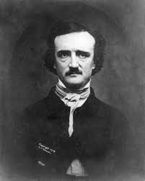
Edgar Allan Poe & Pet Peeves
Mr. Meléndez
English Class
Wednesday, September 11, 2015

Slide 2
Time Management:
Class
Greeting routine
Edgar Allen Poe and Pet Peeves
Activity #1: Identify your pet peeve.
Discussion of activity

Slide 3
Edgar Allan Poe (1809-1849)
Was an American poet, short-story writer, editor and literary critic.
Best known for his tales of mystery and the macabre.
Poe was one of the earliest American practitioners of the short story and is considered the inventor of the detective-fiction genre.
He is further credited with contributing to the emerging genre of science fiction.

Slide 4
Edgar Allan Poe (Life)
His childhood was a miserable one. He lost both of his parents when he was very young and then he was adopted by a wealthy merchant, John Allan. Poe’s relation with the Allan's was unhappy.
He entered University of Virginia and then West Point but did not finish.
He worked as editor and writer most of his life and he was always poor.
At 27 he married his 13 year old cousin, whose death in 1847 left him inconsolable.

Slide 5
Edgar Allan Poe
Significance:
Father of modern short stories
Father of detective stories
Father of psychoanalytic criticism

Slide 6
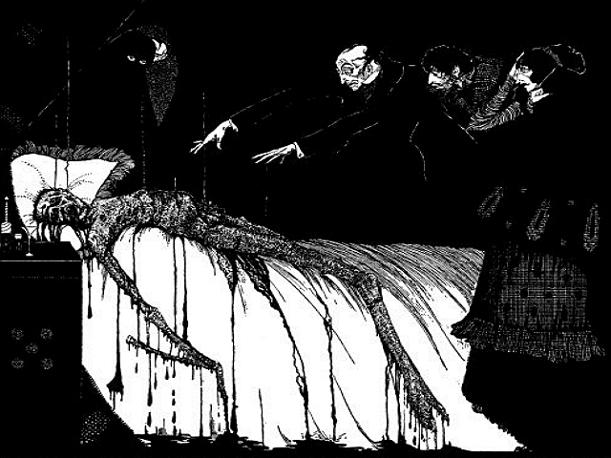
List of Poe’s Work
The Tell-Tale Heart
The Black Cat
The Murders in the Rue Morgue
The Fall of the House of Usher
The Masque of the Red Death
The Cask of Amontillado
The Premature Burial
The Oval Portrait
The Raven
Israfel
Annabel Lee
To Helen

Slide 8
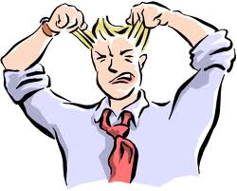
Pet Peeves
Is a minor annoyance that an individual identifies as particularly annoying to himself (or herself), to a greater degree than others may find it.
Involves specific behaviors of people outside your life or someone in your life.
These behaviors may involve disrespect, manners, personal hygiene, family issues, among others.

Slide 9
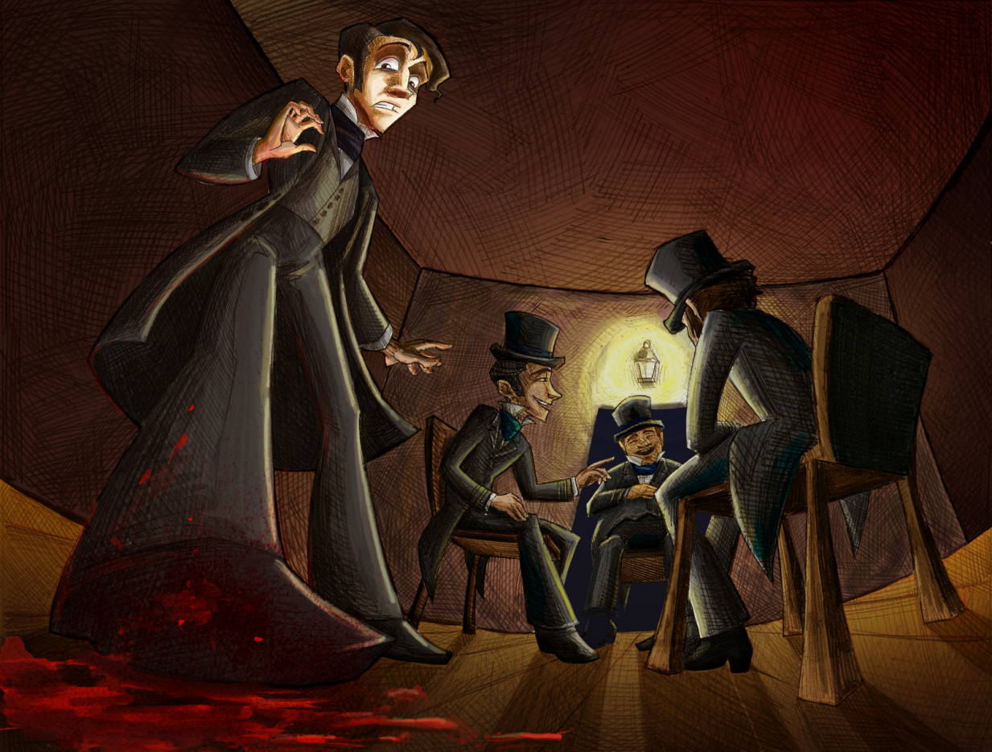
Pet Peeves
They can be in any category in life. Such as:
Politics
Religion
Friends
Family
School
Traffic
Cell phones
Computers
Neighbors
Phobias

Slide 10
Pet Peeve
My Example:
A supervisor may have a pet peeve about people leaving the lid on the copier up and react angrily, be annoyed when others interrupt when speaking, or be upset by messy desks of their subordinates.
To most people, these may seem minor annoyances, but not to the supervisor.
That same supervisor may witness employees coming into work late, and not feel any annoyance whatsoever.

Slide 11
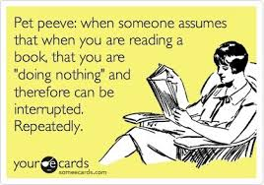

Slide 12
Activity # 1: What is your pet peeve?
Instructions: Write a paragraph mentioning a pet peeve you have and explain why.
Use the following question as a guide to write your paragraph: Is there anything that really annoys you but it doesn’t annoy anyone else?

Slide 13
Time to share your pet peeve!

Slide 14
Questions or Comments:

