Slide 1
Introductory Class:
Christian College
Oscar Correa Agosto
Añasco, Puerto Rico
Mr. Victor Melendez Vargas
English Class (2 days)
Monday, August 24, 2015 and
Tuesday, August 25, 2015

Slide 2
Time Management:
Class
Teacher Self Introduction
Discussion of the Basic Classroom Guidelines
Index Card Activity
Get to Know Me Activity and Class Reflection

Slide 3
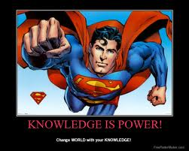
Opening Reflection:

Slide 4
Dialog example: Greeting Routine
Teacher: Good morning students?
Students: Good morning Mr. Melendez.
Teacher: How are you guys doing today?
Students: Fine thank you. And you?
Teacher: I’m doing great. Thank you. Hope you guys are doing great too.

Slide 5
Teacher Self Introduction:
My name is Victor Melendez Vargas.
I was born in Mayagüez, Puerto Rico but I live in Cabo Rojo.
I’m 35 years old.
I was in the US Army for three years.
I went to Korea, Oklahoma and Texas.
After I got out of the Army, I started studies at the Colegio (RUM).

Slide 6
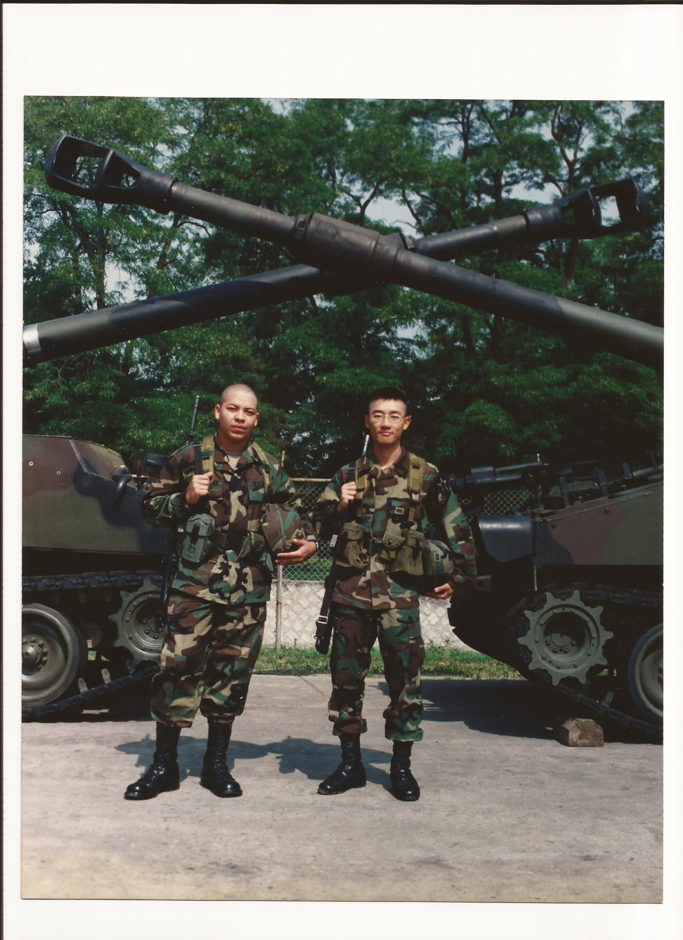
Diversity of backgrounds
Respect is expected at all times.

Slide 7
Classroom General Guidelines:
We will become a learning…

Slide 8
Classroom General Guidelines:
You will treat others as you like to be treated. (_____ Rule)
You will have tolerance towards the learning process of your classmates.
Therefore, no one will laugh at the wrong answers of a classmate.
We are all here to learn, even the teacher.
As humans, we don’t know everything, but we can find out about it.

Slide 9
Classroom General Guidelines:
We will use classroom standard procedures to be discuss later.
We will become a learning community.
The teacher will learn from you and you will learn from the teacher.
I expect you guys to behave as middle/high school students, not as little kids.

Slide 10
Classroom General Guidelines:
I’m expecting a lot of participation in class of everybody.
You guys are very intelligent and can make things happen.
I believe in you guys just as I do in myself.
The classroom will be a safe zone for you to practice English.
We will try to do it at all times!

Slide 11
Activity #1:Get to Know Me!!!
My name is: _________ But I like to be called; _____
2. Three words that best describe me are: ____________
3. My favorite hobbies are: ______________________
4. I dislike: _________________________________
Things I like to do: __________________________
Things I do not like to do: _____________________

Slide 12
Get to Know Me!!!
These are my favorites:
Class:
City:
Sport:
Movie:
Place:
Pet:
Fruit:
Food:
Color:
Music:
Singer:

Slide 13
Teacher Contact Information:
My e-mail address is victorm35@hotmail.com.
The blog for the class will be:
http://mistermelendez.weebly.com

Slide 14
Questions for the teacher:

Slide 15
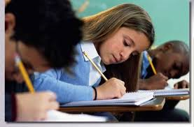
Assessment Activity:
You will have a 1 minute reflection paper to write about the activity.
You will write about what did you like the most and what you did not like.

Slide 16
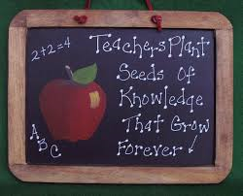
Closing reflection:

